Slide 1
IT305 Computer Networks
Wireless Networks Intro-I

Slide 2
Radio Wave Propagation
Radio channels are extremely random, and are not easily analyzed
Modeling the radio channel is typically done in statistical fashion
[1]
[1]
https://www.vcelink.com/blogs/focus/difference-between-wired-and-wireless-network

Slide 3
Wireless link characteristics: fading (attenuation)
Wireless radio signal attenuates (loses power) as it propagates (free space “path loss”)
Free space path loss ~ (fd)²
f: frequency
d: distance
higher frequency or longer distance
larger free space
path loss
Notes:
Wikipedia figure

Slide 4
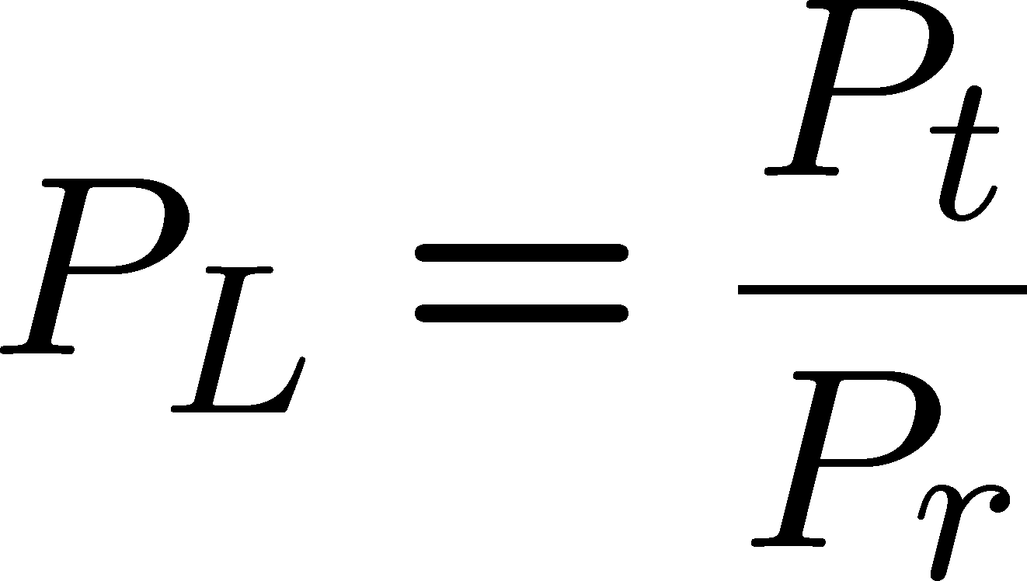
Linear Path Loss
Suppose s(t) of power P_{t} is transmitted through a given channel
The received signal r(t) of power P_{r} is averaged over any random variations due to shadowing.
We define the linear path loss of the channel as the ratio of transmit power to receiver power
We define the path loss of the channel also in dB

Slide 5
Line-of-Sight Propagation
Attenuation
The strength of a signal falls off with distance
Free Space Propagation
The transmitter and receiver – CLEAR line of sight (LOS) path between them. No other sources of impairment!
Satellite systems and microwave systems undergo free space propagation
The free space power received by an antenna which is separated from a radiating antenna by a distance is given by Friis free space equation

Slide 6
Friis Free Space Equation
The relation between the transmit and receive power is given by Friis free space equations:
_{λ} 2
P_{t}
P
P_{r} = P_{t} G_{t} G_{r}
r
(4π d )²
G_{r}
G_{t} and G_{r} are the transmit and^{t} receive antenna gains
λ is the wavelength
d is the T-R separation
P_{t} is the transmitted power
P_{r} is the received power
P_{t} and P_{r} are in same units
G_{t} and G_{r} are dimensionless quantities.

Slide 7


Basic Propagation Mechanisms
Reflection, diffraction, and scattering:
Reflection occurs when a propagating electromagnetic wave impinges upon an object
Diffraction occurs when the radio path between the transmitter and receiver is obstructed by a surface that has sharp edges
Scattering occurs when the medium through which the wave travels
consists of objects with dimensions that are small compared to the wavelength, or
the number of obstacles per unit volume is large.
Scattering
Receiver
Diffraction
Transmitter

Slide 8





Wireless link characteristics: multipath
multipath propagation: radio signal reflects off objects ground, built environment, arriving at destination at slightly different times
reflected path
line of sight
(LOS) path
reflected path

Slide 9
Wireless link characteristics: multipath
multipath propagation: radio signal reflects off objects ground, built environment, arriving at destination at slightly different times
Coherence time:
amount of time bit is present in channel to be received
influences maximum possible transmission rate, since coherence times can not overlap
inversely proportional to
frequency
receiver velocity
transmitted
pulses
time
received
LOS pulse
received
multipath
pulses
received
multipath
pulses
received
LOS pulse
received
pulse
time
T_{c}: coherence time

Slide 10
Wireless link characteristics: noise
interference from other sources on wireless network frequencies: motors, appliances
SNR: signal-to-noise ratio
larger SNR – easier to extract signal from noise (a “good thing”)
SNR versus BER tradeoff
given physical layer: increase power -> increase SNR->decrease BER
SNR may change with mobility: dynamically adapt physical layer (modulation technique, rate)

Slide 11


Wireless link characteristics: hidden terminals
Hidden terminal problem
B, A hear each other
B, C hear each other
A, C can not hear each other means A, C unaware of their interference at B
Attenuation also causes “hidden terminals”
B, A hear each other
B, C hear each other
A, C can not hear each other interfering at B
C
A
B
C
B
A
C’s signal
strength
A’s signal
strength
space

Slide 12


















Elements of a wireless network
wired network
infrastructure

Slide 13




Elements of a wireless network
wireless hosts
laptop, smartphone, IoT
run applications
may be stationary (non-mobile) or mobile
wireless does not always mean mobility!
wired network
infrastructure

Slide 14

Elements of a wireless network
base station
typically connected to wired network
relay - responsible for sending packets between wired network and wireless host(s) in its “area”
e.g., cell towers, 802.11 access points
wired network
infrastructure

Slide 15
Elements of a wireless network
wireless link
typically used to connect mobile(s) to base station, also used as backbone link
multiple access protocol coordinates link access
various transmission rates and distances, frequency bands
wired network
infrastructure

Slide 16
Characteristics of selected wireless links
14 Gbps
802.11ax
10 Gbps
5G
3.5 Gbps
802.11ac
802.11 af,ah
600 Mbps
802.11n
4G LTE
54 Mbps
802.11g
11 Mbps
802.11b
2 Mbps
Bluetooth
Indoor
Outdoor
Midrange
outdoor
Long range
outdoor
10-30m
50-200m
200m-4Km
4Km-15Km

Slide 17
Elements of a wireless network
infrastructure mode
base station connects mobiles into wired network
handoff: mobile changes base station providing connection into wired network
wired network
infrastructure

Slide 18
Elements of a wireless network
ad hoc mode
no base stations
nodes can only transmit to other nodes within link coverage
nodes organize themselves into a network: route among themselves

Slide 19
Wireless network taxonomy
single hop
multiple hops
host connects to base station (WiFi, cellular) which connects to larger Internet
host may have to relay through several wireless nodes to connect to larger
Internet: mesh net
infrastructure
(e.g., APs)
no base station, no connection to larger Internet (Bluetooth, ad hoc nets)
no base station, no connection to larger Internet. May have to relay to reach other a given wireless node MANET, VANET
no
infrastructure

Slide 20
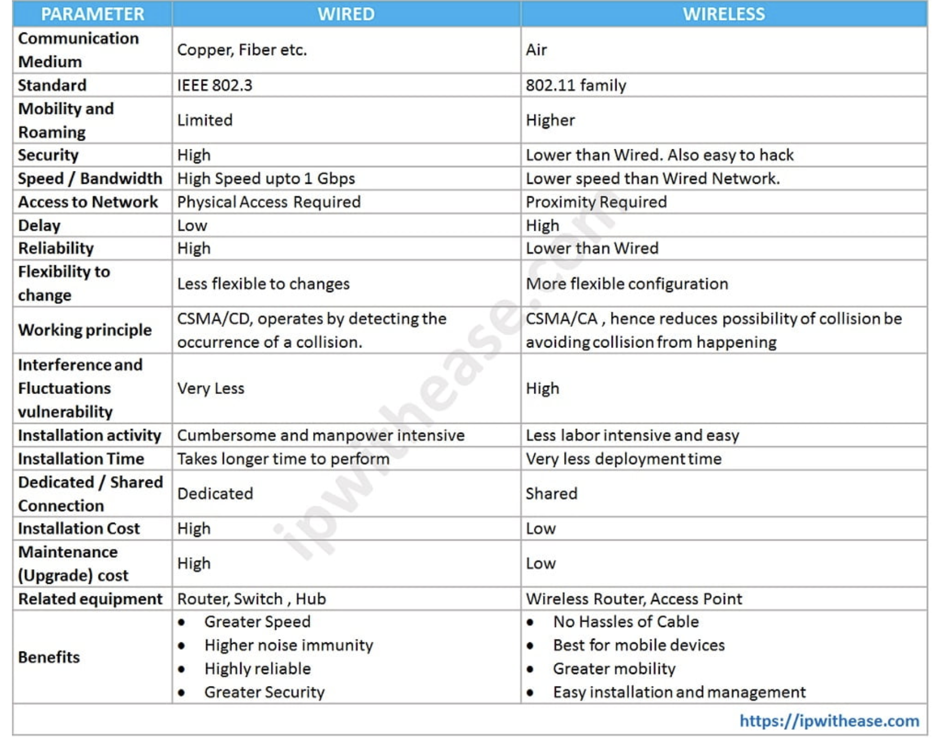
Wired Vs Wireless

